Slide 1
Sequential data mining

Slide 2
Assignment 2
The BATADAL dataset:
https://batadal.net/index.html
Several attack scenario’s on SCADA / ICS systems
Supervisory control and data acquisition
Industrial control systems
In this case, a water distribution network
Attacks on SCADA are some of the most feared cyber attacks

Slide 3
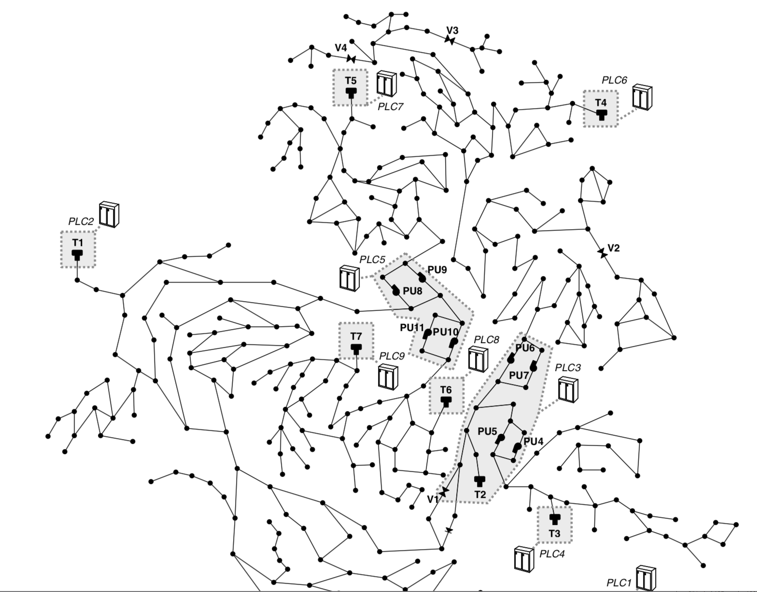

Slide 4
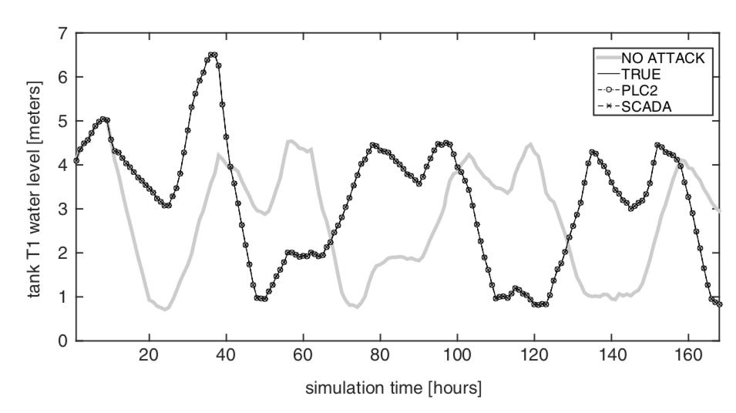
SCADA time series
b

Slide 6
Temporal and Sequential Data
id | value | amount | number | quantity | time
1 | 4 | 2000 | 21 | 30 | 12:30
2 | 4 | 2250 | 35 | 40 | 12:35
1 | 8 | 3000 | 42 | 50 | 12:55
Data often contains temporal information
Should be treated different from other features
Can be used to derive sequence information
Special methods exist for such sequential data
Model-free - distances
Model-based – (Markov) models
Important distinction:
Continuous vs. discrete signals

Slide 7
Analysis of Sequential Data
Sequential structure arises in a huge range of applications
Repeated measurements of a temporal process – time series
Online decision making & control
Text, biological sequences
System and process logs
Standard machine learning methods can be applied, but:
They do not exploit temporal patterns
Computation & storage scales poorly to realistic applications
Many methods visualize the sequential structure
Useful for understanding and analysis

Slide 8
Overview
Applying standard machine learning methods
Time slicing, sliding windows
Computing distances
Modeling time-series
Auto-Regressive Moving Average (ARMA)
Filtering noise, Fourier transform
Discrete models
Markov chains
N-grams
More sequential models in Software Data lecture!

Slide 9
Time slicing
Simple idea:
Group rows based on their time value
Are they early or late in the process?
Learn different models for the different groups

Slide 10
Time slicing
id | value | amount | number | quantity | time
1 | 4 | 2000 | 21 | 30 | 12:30
2 | 4 | 2250 | 35 | 40 | 12:35
1 | 8 | 3000 | 42 | 50 | 12:55
3 | 10 | 3300 | 15 | 55 | 13:00
1 | 11 | 3400 | 36 | 60 | 13:15
2 | 6 | 3500 | 14 | 65 | 13:20
2 | 8 | 3800 | 50 | 70 | 13:35
3 | 10 | 4000 | 42 | 80 | 13:40
1 | 14 | 4100 | 27 | 85 | 13:55
3 | 12 | 4200 | 33 | 90 | 14:00

Slide 11
Time slicing
id | value | amount | number | quantity | time | slice
1 | 4 | 2000 | 21 | 30 | 12:30 | ?
2 | 4 | 2250 | 35 | 40 | 12:35 | ?
1 | 8 | 3000 | 42 | 50 | 12:55 | ?
3 | 10 | 3300 | 15 | 55 | 13:00 | ?
1 | 11 | 3400 | 36 | 60 | 13:15 | ?
2 | 6 | 3500 | 14 | 65 | 13:20 | ?
2 | 8 | 3800 | 50 | 70 | 13:35 | ?
3 | 10 | 4000 | 42 | 80 | 13:40 | ?
1 | 14 | 4100 | 27 | 85 | 13:55 | ?
3 | 12 | 4200 | 33 | 90 | 14:00 | ?

Slide 12
Time slicing
id | value | amount | number | quantity | time | slice
1 | 4 | 2000 | 21 | 30 | 12:30 | ?
2 | 4 | 2250 | 35 | 40 | 12:35 | ?
1 | 8 | 3000 | 42 | 50 | 12:55 | ?
3 | 10 | 3300 | 15 | 55 | 13:00 | ?
1 | 11 | 3400 | 36 | 60 | 13:15 | ?
2 | 6 | 3500 | 14 | 65 | 13:20 | ?
2 | 8 | 3800 | 50 | 70 | 13:35 | ?
3 | 10 | 4000 | 42 | 80 | 13:40 | ?
1 | 14 | 4100 | 27 | 85 | 13:55 | ?
3 | 12 | 4200 | 33 | 90 | 14:00 | ?
What to fill in?

Slide 13
Time slicing - overall
combine first/last occurrences of rows
id | value | amount | number | quantity | time | slice
1 | 4 | 2000 | 21 | 30 | 12:30 | 1
2 | 4 | 2250 | 35 | 40 | 12:35 | 1
1 | 8 | 3000 | 42 | 50 | 12:55 | 1
3 | 10 | 3300 | 15 | 55 | 13:00 | 1
1 | 11 | 3400 | 36 | 60 | 13:15 | 1
2 | 6 | 3500 | 14 | 65 | 13:20 | 2
2 | 8 | 3800 | 50 | 70 | 13:35 | 2
3 | 10 | 4000 | 42 | 80 | 13:40 | 2
1 | 14 | 4100 | 27 | 85 | 13:55 | 2
3 | 12 | 4200 | 33 | 90 | 14:00 | 2

Slide 14
Time slicing – process dependent
combine first/last occurrences of different process ids
id | value | amount | number | quantity | time | slice
1 | 4 | 2000 | 21 | 30 | 12:30 | 1
2 | 4 | 2250 | 35 | 40 | 12:35 | 1
1 | 8 | 3000 | 42 | 50 | 12:55 | 1
3 | 10 | 3300 | 15 | 55 | 13:00 | 1
1 | 11 | 3400 | 36 | 60 | 13:15 | 2
2 | 6 | 3500 | 14 | 65 | 13:20 | 1
2 | 8 | 3800 | 50 | 70 | 13:35 | 2
3 | 10 | 4000 | 42 | 80 | 13:40 | 1
1 | 14 | 4100 | 27 | 85 | 13:55 | 2
3 | 12 | 4200 | 33 | 90 | 14:00 | 2

Slide 15
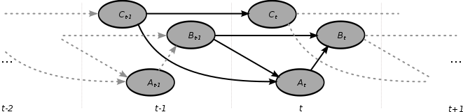
Once sliced
Learn a model for every slice
Model and learn the dependencies between the models, eg, using a Dynamic Bayesian Network:

Slide 16
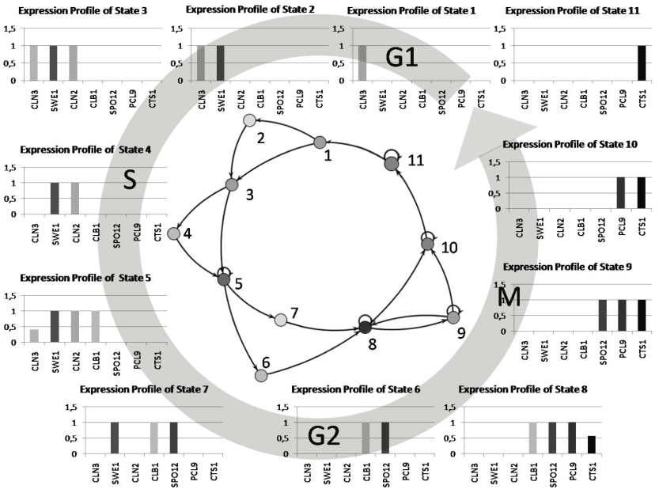
Time slicing
Often applied in patient modeling (e-health)
How to slice depends entirely on the application
Smarter methods exists if you can
determine the “state” of a system:
Slice value equal to
state number
State is discovered using
sequential models, lecture on
software models…
yeast cell cycle – Schmidt et al.

Slide 17
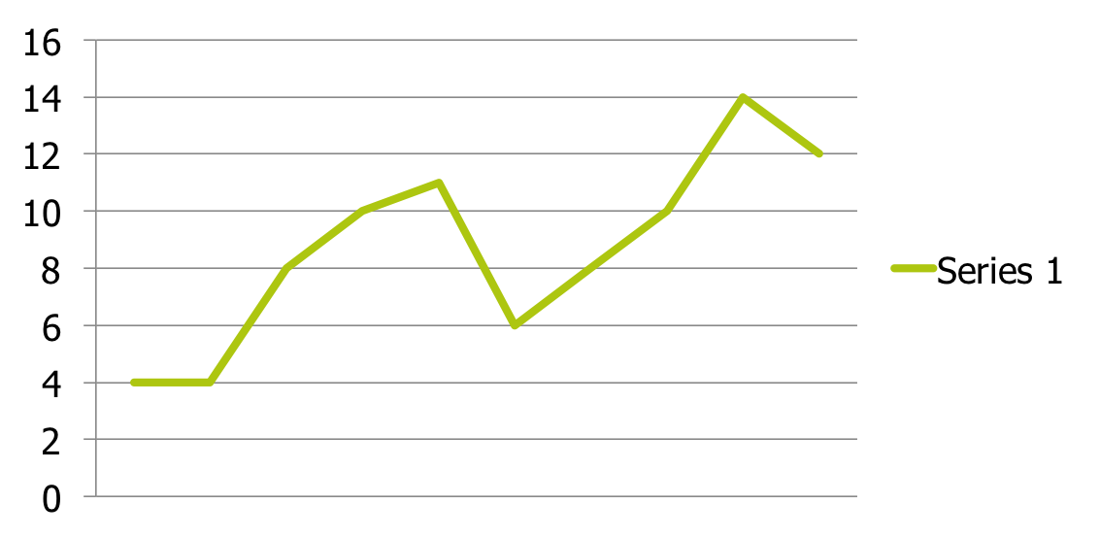
Sliding windows
Slice the data dependent on the current time point:

Slide 18
Sliding windows
Slice the data dependent on the current time point:
1st slice
2nd slice
3rd slice

Slide 19
Sliding windows
value | amount
4 | 2000
4 | 2250
8 | 3000
10 | 3300
11 | 3400
6 | 3500
8 | 3800
10 | 4000
14 | 4100
12 | 4200

Slide 20
Sliding windows
value | amount
4 | 2000
4 | 2250
8 | 3000
10 | 3300
11 | 3400
6 | 3500
8 | 3800
10 | 4000
14 | 4100
12 | 4200

Slide 21
Sliding windows
value | amount
4 | 2000
4 | 2250
8 | 3000
10 | 3300
11 | 3400
6 | 3500
8 | 3800
10 | 4000
14 | 4100
12 | 4200
v1 | a1 | v2 | a2 | v3 | a3
? | ? | ? | ? | ? | ?

Slide 22
Sliding windows
value | amount
4 | 2000
4 | 2250
8 | 3000
10 | 3300
11 | 3400
6 | 3500
8 | 3800
10 | 4000
14 | 4100
12 | 4200
v1 | a1 | v2 | a2 | v3 | a3
4 | 2000 | 4 | 2250 | 8 | 3000

Slide 23
Sliding windows
value | amount
4 | 2000
4 | 2250
8 | 3000
10 | 3300
11 | 3400
6 | 3500
8 | 3800
10 | 4000
14 | 4100
12 | 4200
v1 | a1 | v2 | a2 | v3 | a3
4 | 2000 | 4 | 2250 | 8 | 3000
? | ? | ? | ? | ? | ?

Slide 24
Sliding windows
value | amount
4 | 2000
4 | 2250
8 | 3000
10 | 3300
11 | 3400
6 | 3500
8 | 3800
10 | 4000
14 | 4100
12 | 4200
v1 | a1 | v2 | a2 | v3 | a3
4 | 2000 | 4 | 2250 | 8 | 3000
4 | 2250 | 8 | 3000 | 10 | 3300

Slide 25
Sliding windows
value | amount
4 | 2000
4 | 2250
8 | 3000
10 | 3300
11 | 3400
6 | 3500
8 | 3800
10 | 4000
14 | 4100
12 | 4200
v1 | a1 | v2 | a2 | v3 | a3
4 | 2000 | 4 | 2250 | 8 | 3000
4 | 2250 | 8 | 3000 | 10 | 3300
8 | 3000 | 10 | 3300 | 11 | 3400
10 | 3300 | 11 | 3400 | 6 | 3500
11 | 3400 | 6 | 3500 | 8 | 3800
6 | 3500 | 8 | 3800 | 10 | 4000
8 | 3800 | 10 | 4000 | 14 | 4100
10 | 4000 | 14 | 4100 | 12 | 4200
14 | 4100 | 12 | 4200 | ? | ?
12 | 4200 | ? | ? | ? | ?

Slide 26
Sliding windows
value | amount
4 | 2000
4 | 2250
8 | 3000
10 | 3300
11 | 3400
6 | 3500
8 | 3800
10 | 4000
14 | 4100
12 | 4200
v1 | a1 | v2 | a2 | v3 | a3
4 | 2000 | 4 | 2250 | 8 | 3000
4 | 2250 | 8 | 3000 | 10 | 3300
8 | 3000 | 10 | 3300 | 11 | 3400
10 | 3300 | 11 | 3400 | 6 | 3500
11 | 3400 | 6 | 3500 | 8 | 3800
6 | 3500 | 8 | 3800 | 10 | 4000
8 | 3800 | 10 | 4000 | 14 | 4100
10 | 4000 | 14 | 4100 | 12 | 4200
14 | 4100 | 12 | 4200 | ? | ?
12 | 4200 | ? | ? | ? | ?
And then apply any ML technique, or
do we see any issues?

Slide 27
Sliding windows
Usually applied to time-series data:
Measurements at a fixed temporal rate
i.e., financial data, audio signals
Harder to apply when timings are not fixed (event-timestamp)
Any machine learning method can be used with:
Standard distance measures, e.g., Euclidian
Special temporal distances, e.g., Dynamic Time Warping
Symbolic approximations
But
Only takes a fixed-length history into account
Causes a modellin blowup
When start-end points are known for sequences, use them!...

Slide 28
Blowup example
value
A
B
C
D
A
B
C
D
A
B
C
D
v1 | v2 | v3 | v4
A | B | C | D
B | C | D | A
C | D | A | B
D | A | B | C
A | B | C | D
B | C | D | A
C | D | A | B
A lot of relationships, e.g., if v1 = A then v2 = B, etc...

Slide 29
Blowup example
value
A
B
C
D
A
B
C
D
A
B
C
D
v1 | v2 | v3 | v4
A | B | C | D
A | B | C | D
A | B | C | D
A much simpler representation,
leads to much simpler models and better performance

Slide 30
Overview
Applying standard machine learning methods
Time slicing, sliding windows
Computing distances
Modeling time-series
Auto-Regressive Moving Average (ARMA)
Filtering noise, Fourier transform
Discrete models
Markov chains
N-grams

Slide 31

Shape often matters most
Are these series similar? Their y-ranges are very different…
check out: http://www.tylervigen.com/spurious-correlations

Slide 32
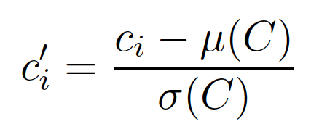
Scaling time series
In order to compare shapes, we need to scale the series:
for every data point ci, where μ is the mean and σ is the standard deviation of the series
After normalization, we can compute distances between sliding windows

Slide 33
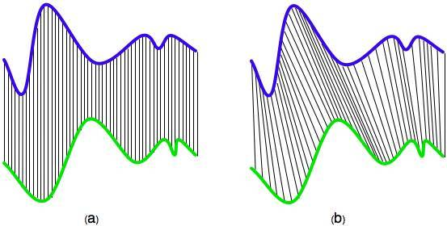
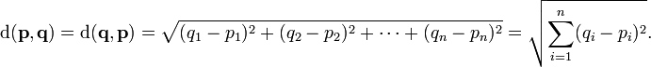
Euclidean distance

Slide 34
Euclidean distance
 | v1 | v2 | v3 | v4 | v5 | v6 | v7 | v8
s1 | 10 | 15 | 20 | 30 | 0 | 25 | 10 | 20
s2 | 20 | 30 | 0 | 30 | 25 | 15 | 20 | 10
(s1–s2)² | 100 | 225 | 400 | 0 | 625 | 100 | 100 | 100
Distance = sqrt(100+225+400+0+625+100+100+100) = 40.62

Slide 35
Euclidean distance
 | v1 | v2 | v3 | v4 | v5 | v6 | v7 | v8
s1 | 10 | 15 | 20 | 30 | 0 | 25 | 10 | 20
s2 | 20 | 30 | 0 | 30 | 25 | 15 | 20 | 10
(s1–s2)² | 100 | 225 | 400 | 0 | 625 | 100 | 100 | 100
Distance = sqrt(100+225+400+0+625+100+100+100) = 40.62
Signals seem out of phase…

Slide 36
Dynamic Time Warping or sequence alignment
Aligns time-series non-linearly in time, finds the best match

Slide 37
Dynamic Time Warping or sequence alignment
Lines are not allowed to cross, keeping shape intact
Aligns time-series non-linearly in time, finds the best match

Slide 38
Time-warping distance
 | v1 | v2 | v3 | v4 | v5 | v6 | v7 | v8
s1 | 10 | 15 | 20 | 30 | 0 | 25 | 10 | 20
s2 | 20 | 30 | 0 | 30 | 25 | 15 | 20 | 10
s1/s2 | v1 | v2 | v3 | v4 | v5 | v6 | v7 | v8
v1 | 100
v2 |  | 225
v3 |  |  | 400
v4 |  |  |  | 0
v5 |  |  |  |  | 625
v6 |  |  |  |  |  | 100
v7 |  |  |  |  |  |  | 100
v8 |  |  |  |  |  |  |  | 100

Slide 39
Time-warping distance
 | v1 | v2 | v3 | v4 | v5 | v6 | v7 | v8
s1 | 10 | 15 | 20 | 30 | 0 | 25 | 10 | 20
s2 | 20 | 30 | 0 | 30 | 25 | 15 | 20 | 10
s1/s2 | v1 | v2 | v3 | v4 | v5 | v6 | v7 | v8
v1 | 100 | 400 | 100 | 400 | 225 | 25 | 100 | 0
v2 | 25 | 225 | 225 | 225 | 100 | 0 | 25 | 25
v3 | 0 | 100 | 400 | 100 | 25 | 25 | 0 | 100
v4 | 100 | 0 | 900 | 0 | 25 | 225 | 100 | 400
v5 | 400 | 900 | 0 | 900 | 625 | 225 | 400 | 100
v6 | 25 | 25 | 625 | 25 | 0 | 100 | 25 | 225
v7 | 100 | 400 | 100 | 400 | 225 | 25 | 100 | 0
v8 | 0 | 100 | 400 | 100 | 25 | 25 | 0 | 100

Slide 40
Time-warping distance
 | v1 | v2 | v3 | v4 | v5 | v6 | v7 | v8
s1 | 10 | 15 | 20 | 30 | 0 | 25 | 10 | 20
s2 | 20 | 30 | 0 | 30 | 25 | 15 | 20 | 10
s1/s2 | v1 | v2 | v3 | v4 | v5 | v6 | v7 | v8
v1 | 100 | 400 | 100 | 400 | 225 | 25 | 100 | 0
v2 | 25 | 225 | 225 | 225 | 100 | 0 | 25 | 25
v3 | 0 | 100 | 400 | 100 | 25 | 25 | 0 | 100
v4 | 100 | 0 | 900 | 0 | 25 | 225 | 100 | 400
v5 | 400 | 900 | 0 | 900 | 625 | 225 | 400 | 100
v6 | 25 | 25 | 625 | 25 | 0 | 100 | 25 | 225
v7 | 100 | 400 | 100 | 400 | 225 | 25 | 100 | 0
v8 | 0 | 100 | 400 | 100 | 25 | 25 | 0 | 100
Find a minimum cost path from left top to bottom right

Slide 41
Time-warping distance
 | v1 | v2 | v3 | v4 | v5 | v6 | v7 | v8
s1 | 10 | 15 | 20 | 30 | 0 | 25 | 10 | 20
s2 | 20 | 30 | 0 | 30 | 25 | 15 | 20 | 10
s1/s2 | v1 | v2 | v3 | v4 | v5 | v6 | v7 | v8
v1 | 100 | 400 | 100 | 400 | 225 | 25 | 100 | 0
v2 | 25 | 225 | 225 | 225 | 100 | 0 | 25 | 25
v3 | 0 | 100 | 400 | 100 | 25 | 25 | 0 | 100
v4 | 100 | 0 | 900 | 0 | 25 | 225 | 100 | 400
v5 | 400 | 900 | 0 | 900 | 625 | 225 | 400 | 100
v6 | 25 | 25 | 625 | 25 | 0 | 100 | 25 | 225
v7 | 100 | 400 | 100 | 400 | 225 | 25 | 100 | 0
v8 | 0 | 100 | 400 | 100 | 25 | 25 | 0 | 100
Find a minimum cost path from left top to bottom right
Without going up or left (crossing)

Slide 42
Time-warping distance
 | v1 | v2 | v3 | v4 | v5 | v6 | v7 | v8
s1 | 10 | 15 | 20 | 30 | 0 | 25 | 10 | 20
s2 | 20 | 30 | 0 | 30 | 25 | 15 | 20 | 10
s1/s2 | v1 | v2 | v3 | v4 | v5 | v6 | v7 | v8
v1 | 100 | 400 | 100 | 400 | 225 | 25 | 100 | 0
v2 | 25 | 225 | 225 | 225 | 100 | 0 | 25 | 25
v3 | 0 | 100 | 400 | 100 | 25 | 25 | 0 | 100
v4 | 100 | 0 | 900 | 0 | 25 | 225 | 100 | 400
v5 | 400 | 900 | 0 | 900 | 625 | 225 | 400 | 100
v6 | 25 | 25 | 625 | 25 | 0 | 100 | 25 | 225
v7 | 100 | 400 | 100 | 400 | 225 | 25 | 100 | 0
v8 | 0 | 100 | 400 | 100 | 25 | 25 | 0 | 100
Find a minimum cost path from left top to bottom right
Without going up or left (crossing)
For instance…

Slide 43
Time-warping distance
 | v1 | v2 | v3 | v4 | v5 | v6 | v7 | v8
s1 | 10 | 15 | 20 | 30 | 0 | 25 | 10 | 20
s2 | 20 | 30 | 0 | 30 | 25 | 15 | 20 | 10
s1/s2 | v1 | v2 | v3 | v4 | v5 | v6 | v7 | v8
v1 | 100 | 400 | 100 | 400 | 225 | 25 | 100 | 0
v2 | 25 | 225 | 225 | 225 | 100 | 0 | 25 | 25
v3 | 0 | 100 | 400 | 100 | 25 | 25 | 0 | 100
v4 | 100 | 0 | 900 | 0 | 25 | 225 | 100 | 400
v5 | 400 | 900 | 0 | 900 | 625 | 225 | 400 | 100
v6 | 25 | 25 | 625 | 25 | 0 | 100 | 25 | 225
v7 | 100 | 400 | 100 | 400 | 225 | 25 | 100 | 0
v8 | 0 | 100 | 400 | 100 | 25 | 25 | 0 | 100
Distance = sqrt(100+25+0+0+0+25+0+25+100) = 16.58

Slide 44
Time-warping distance
Before alignment
 | v1 | v2 | v3 | v4 | v5 | v6 | v7 | v8
s1 | 10 | 15 | 20 | 30 | 0 | 25 | 10 | 20
s2 | 20 | 30 | 0 | 30 | 25 | 15 | 20 | 10
After alignment
v/v | 1/1 | 2/1 | 3/1 | 4/2 | 5/3 | 6/4 | 6/5 | 7/6 | 8/7 | 8/8
s1 | 10 | 15 | 20 | 30 | 0 | 25 | 25 | 10 | 20 | 10
s2 | 20 | 20 | 20 | 30 | 0 | 30 | 25 | 15 | 20 | 10
Although we consider more points,
their synchronisation gives a smaller distance!

Slide 45
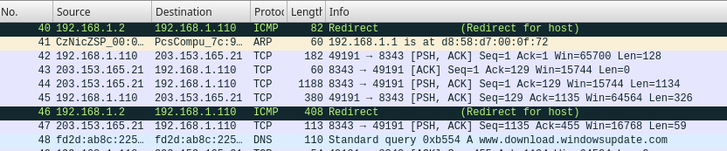
Applications in real world
Extensive use in
Speech recognition
Gesture recognition
Handwriting recognition
…
But now, also in
Clustering malware behavior

Slide 46
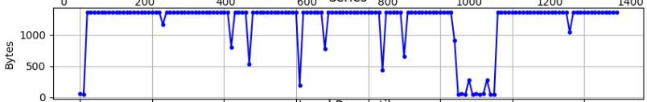
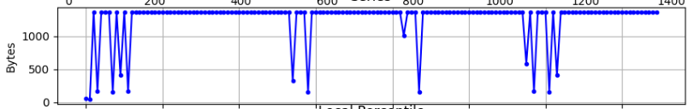
Example: Clustering malware
Zeus-738f →
Gozi-4bd7 →
DTW on network traffic with clustering identifies malware families
A. Nadeem et al.
Notes:
Show pcap first

Slide 47
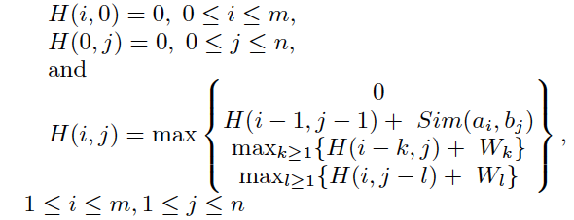
Sequence alignment
Discrete variant of time-warping
Build matrix using (dynamic programming):
where W is a gap penalty

Slide 48
Sequence alignment
Discrete variant of time-warping
Build matrix using (dynamic programming):
where W is a gap penalty
Diagonal
Right
Down

Slide 49
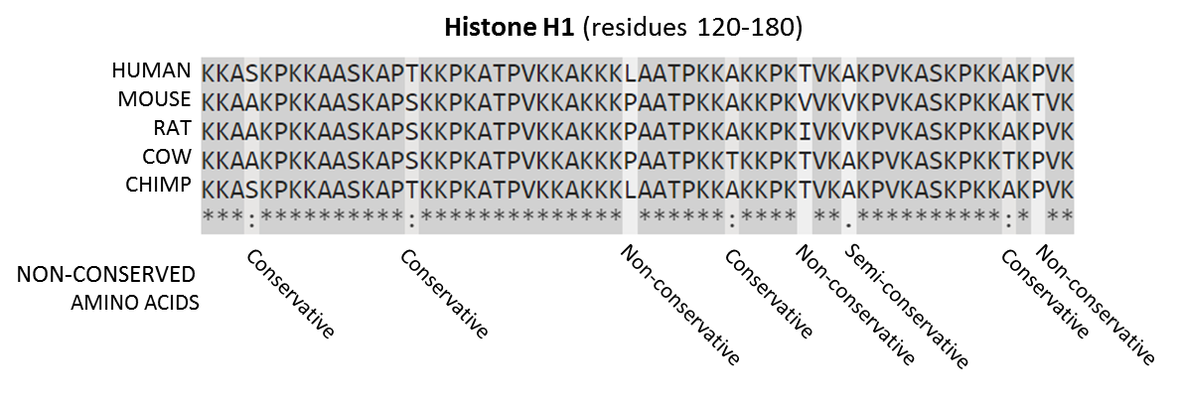
Sequence alignment
Discrete variant of time-warping
Build matrix using:
where W is the gap penalty
Very popular in bioinformatics:

Slide 50
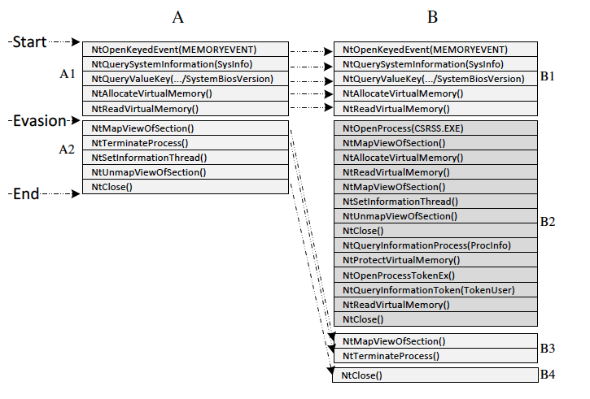
Sequence alignment
Also used for system call traces:
Discrete variant of time-warping
Build matrix using:
where W is the gap penalty
Very popular in bioinformatics:

Slide 51
So far
Time slicing:
assign slice values, incrementing over time
learn different models for different slices
Sliding windows:
obtain fixed length rows by moving a window over the series
learn a model from the obtained data table
Distances with sequential orders:
first normalize if shape matters
Euclidean distance is OK for synchronized series
Time warping/sequence alignment handles out-of-sync series
Possible to include gaps to allow for noise

Slide 52
Overview
Applying standard machine learning methods
Time slicing, sliding windows
Computing distances
Modeling time-series
Auto-Regressive Moving Average (ARMA)
Filtering noise, Fourier transform
Discrete sequential models
Markov chains
N-grams

Slide 53
Time series prediction
 | v1 | v2 | v3 | v4 | v5 | v6 | v7 | v8
w1 | 10 | 15 | 20 | 30 | 0 | 25 | 10 | 20
w2 | 15 | 20 | 30 | 0 | 25 | 10 | 20 | 15
w3 | 20 | 30 | 0 | 25 | 10 | 20 | 15 | 10
w4 | 30 | 0 | 25 | 10 | 20 | 15 | 10 | 25
Predict v8, based on v1, .., v7
Can use any predictor such as Regression Trees, Probabilistic Models, Linear/Polynomial Regression
Common baseline: persistence – predict the last value
The most common time series model is one that combines an autoregressive and moving average parts...

Slide 54
Auto regressive
The notation AR(p) refers to the autoregressive model of order p. The AR(p) model is written as:
where X is a random variable, φ are coefficients, ε is white noise
An auto-regressive model is a linear regression of the current value against previous values
p is the model order (sliding window length)

Slide 55
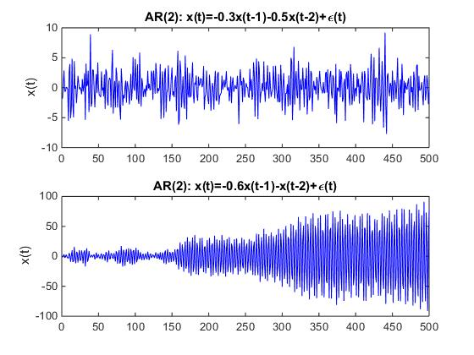
AR(p) for p=2 and different φ
What does the signal look like?

Slide 56
AR(p) for p=2 and different φ

Slide 57
AR(p) for p=2 and different φ
keeping coefficients between -1 and 1 avoids this blowup, values can depend on values long ago...

Slide 58
Modeling noise
The notation MA(q) refers to the moving average model of order q. The MA(q) model is written as:
where X is a random variable, μ is the mean of the entire series, θ are coefficients, ε is white noise
a moving-average model is a linear regression of the current value against previous error terms (aka residuals)
A moving-average model is a linear regression to describe how the random variables fluctuate around mean of the series, can model correlated noise.

Slide 59
Modeling noise
The notation MA(q) refers to the moving average model of order q. The MA(q) model is written as:
where X is a random variable, μ is the mean of the entire series, θ are coefficients, ε is white noise
a moving-average model is a linear regression of the current value against previous error terms (aka residuals)
A moving-average model is a linear regression to describe how the random variables fluctuate around mean of the series, can model correlated noise.
for instance: if there was the signal was much larger then expected yesterday, it will likely be larger again today.

Slide 60
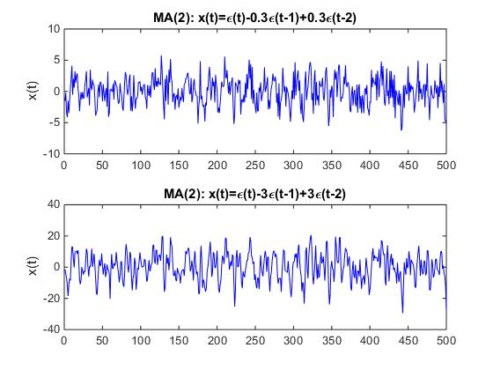
MA(q) for q=2 and different θ
What does the signal look like?

Slide 61
MA(q) for q=2 and different θ
MA models are always stationary
(fluctuate around the mean), no long dependencies

Slide 62
Auto regressive-moving average
ARMA (p,q) is written as:
order
coefficient

Slide 63
Auto regressive-moving average
ARMA (p,q) is written as:
order
coefficient
ARMA is one of the most frequently used models for time-series prediction

Slide 64
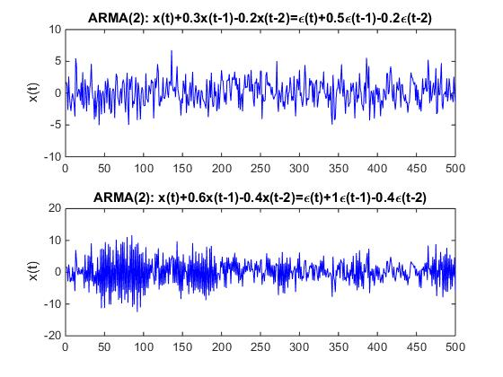
ARMA(p,q) for p,q=2 and different φ, θ

Slide 65
ARMA(p,q) for p,q=2 and different φ, θ
Here the errors are white-noise, when modeling data, these should be replaced by the residual errors

Slide 66
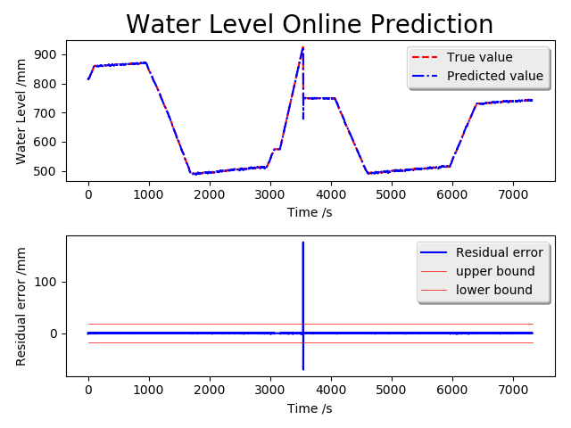
Predicting SCADA using AR
X_t = 1.4*X_(t-1)-0.063*X_(t-2)-0.338*X_(t-3)+e

Slide 67
Predicting SCADA using AR
Model gets “reset” after every prediction
Removes the effect we get when generating new series
X_t = 1.4*X_(t-1)-0.063*X_(t-2)-0.338*X_(t-3)+e

Slide 68
Stationary
A time series is stationary when its statistical properties such as mean, variance, autocorrelation, etc. are all constant over time
ARMA models like data to be stationary
Differencing can be used to make a series more stationary
Replace: X_t = X_t – X_(t-1)
Iterate if needed
ARIMA(p,d,q) has an additional parameter q for the amount of differencing to use

Slide 69
Estimating parameters for MA, AR, ARMA models
AR is a special instance of linear regression, φ parameters can be estimated via ordinary least squares
MA can be a non-linear form of regression, estimation of θ parameters requires some form of search (it depends on the residuals), it can be hard to find the optimal values
ARMA is hard since MA is hard
Estimation of model orders can be done using (partial) autocorrelation plots and/or model selection methods

Slide 70
Order estimation
Partial autocorrelation (PACF)
partial correlation of series with own lagged values, regressing away all values at smaller lags, use to set order p for AR model
include lags with significant correlation that cannot be explained by smaller lags
Autocorrelation (ACF)
correlation of series with own lagged values
use to set order for MA model, the ACF cuts off after q lags (the noise fluctuations only depend q lags)
but there is interaction with differencing...
Use grid-search, model selection, or simulation, see links on Brightspace for more information

Slide 71
Overview
Applying standard machine learning methods
Time slicing, sliding windows → order, how far to look back in time
Computing distances → shapes matter, normalize, align
Modeling time-series
Auto-Regressive (AR) → similar to sliding window, use PACF
Moving Average (MA) → models fluctuations, use ACF
Filtering noise, Fourier transform → see end of presentation
Discrete sequential models
Markov chains
N-grams

Slide 72
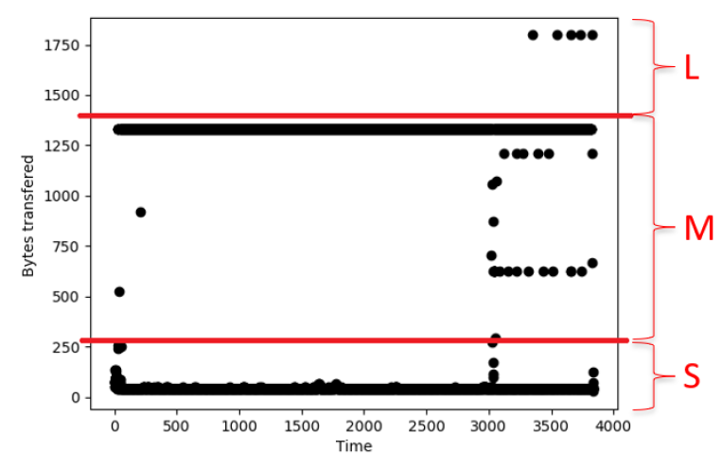
Making data points symbolic: percentiles

Slide 73
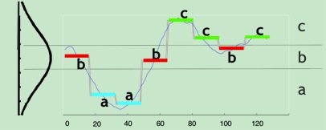
Symbolic approximation of time series
Approximate a value using (fixed) ranges
to get symbolic sequences

Slide 74
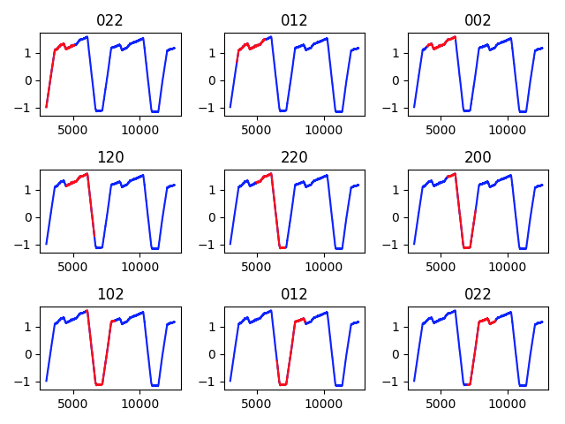
SAX (Symbolic Aggregate approXimation)
Estimate mean values of same-size windows
Normalize values in every window separately
0 -> low, 1 -> middle, 2 -> high

Slide 75
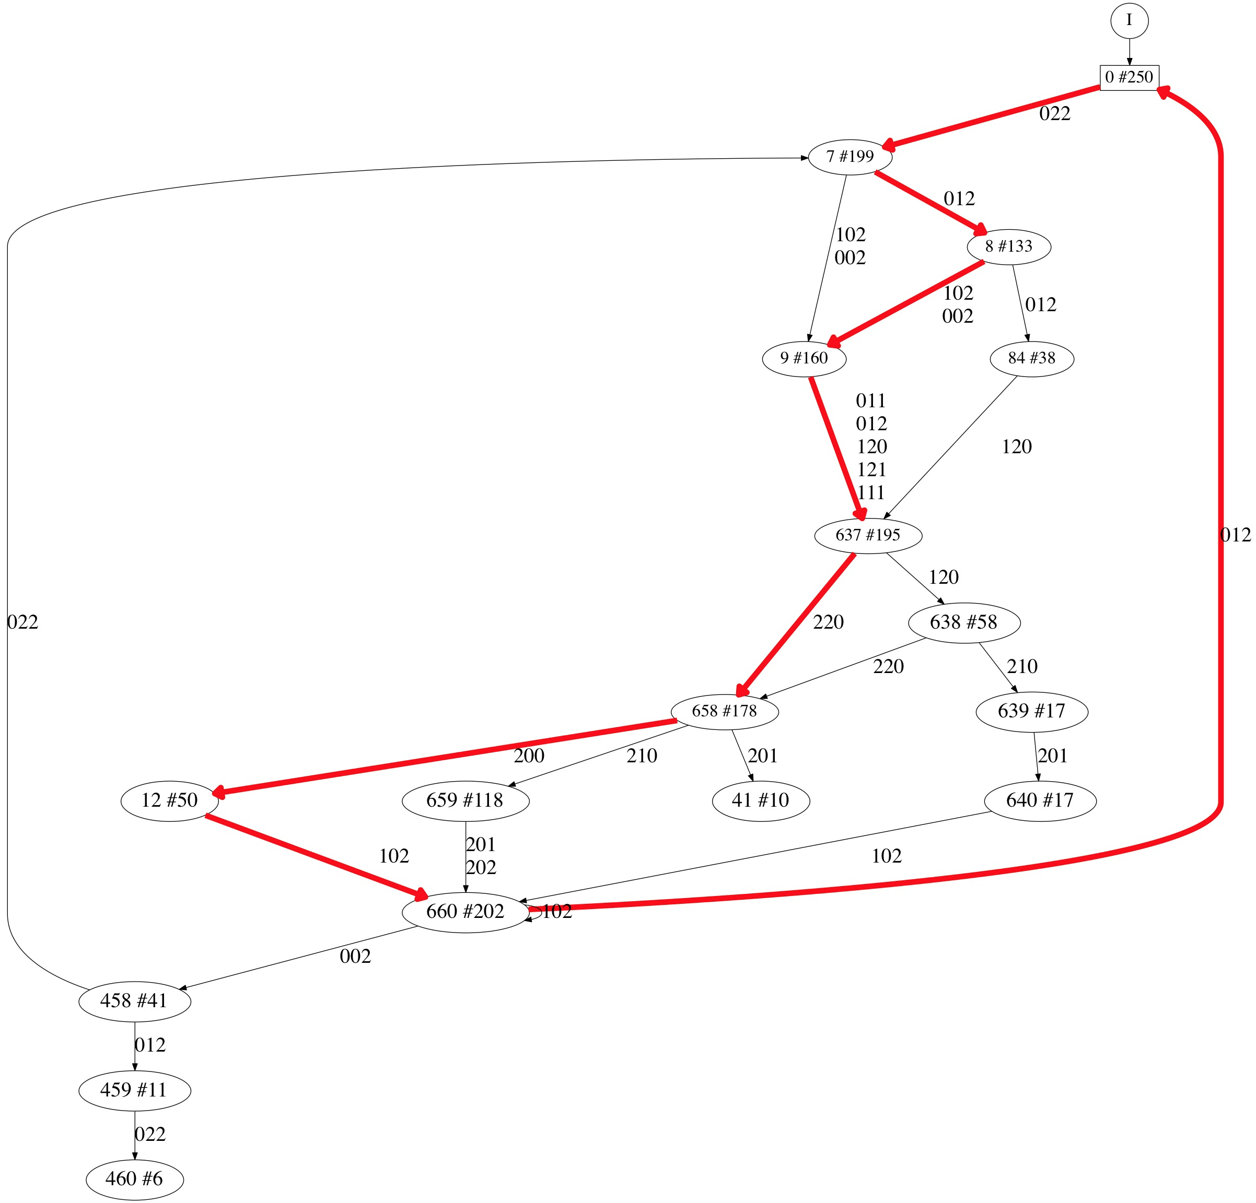
Build state machine model of signal
Model shows cyclic
behavior in SCADA signals
Can be used for anomaly
detection

Slide 76
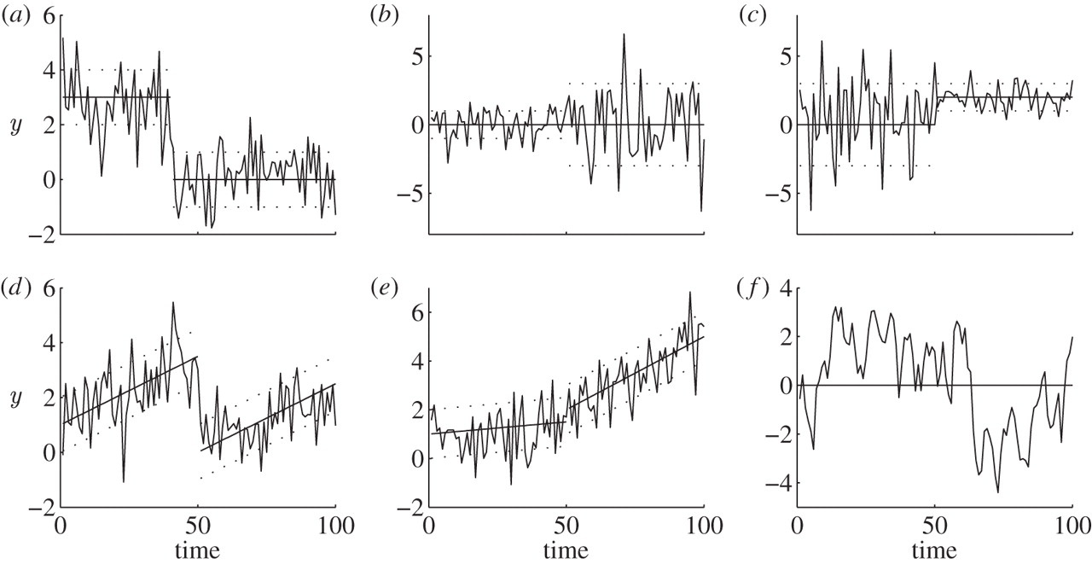
Change point detection and segmentation
Many methods exist for detection change points, such as abrupt trend or distribution changes

Slide 77
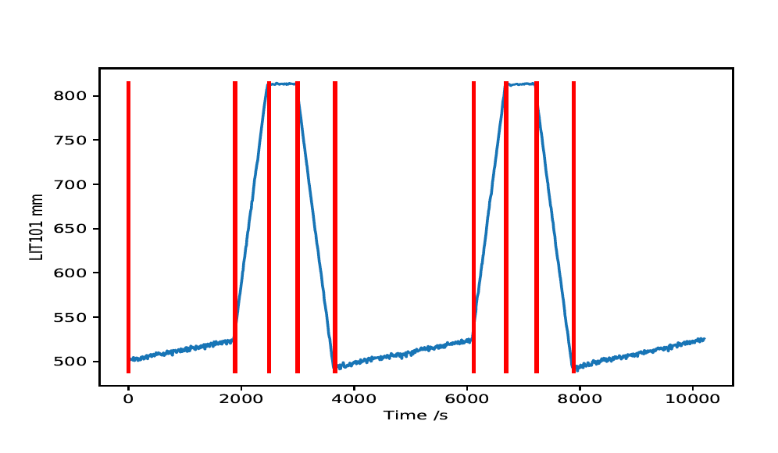
In SCADA cyclic behavior
Simple algorithm:
Add next point to linear segment

Slide 78
In SCADA cyclic behavior
Simple algorithm:
Add next point to linear segment
Compute regression error e

Slide 79
In SCADA cyclic behavior
Simple algorithm:
Add next point to linear segment
Compute regression error e
If e < bound -> goto 1

Slide 80
In SCADA cyclic behavior
Simple algorithm:
Add next point to linear segment
Compute regression error e
If e < bound -> goto 1

Slide 81
In SCADA cyclic behavior
Simple algorithm:
Add next point to linear segment
Compute regression error e
If e < bound -> goto 1
Else -> cut at point of largest error, continue from there

Slide 82
In SCADA cyclic behavior
Simple algorithm:
Add next point to linear segment
Compute regression error e
If e < bound -> goto 1
Else -> cut at point of largest error, continue from there

Slide 83
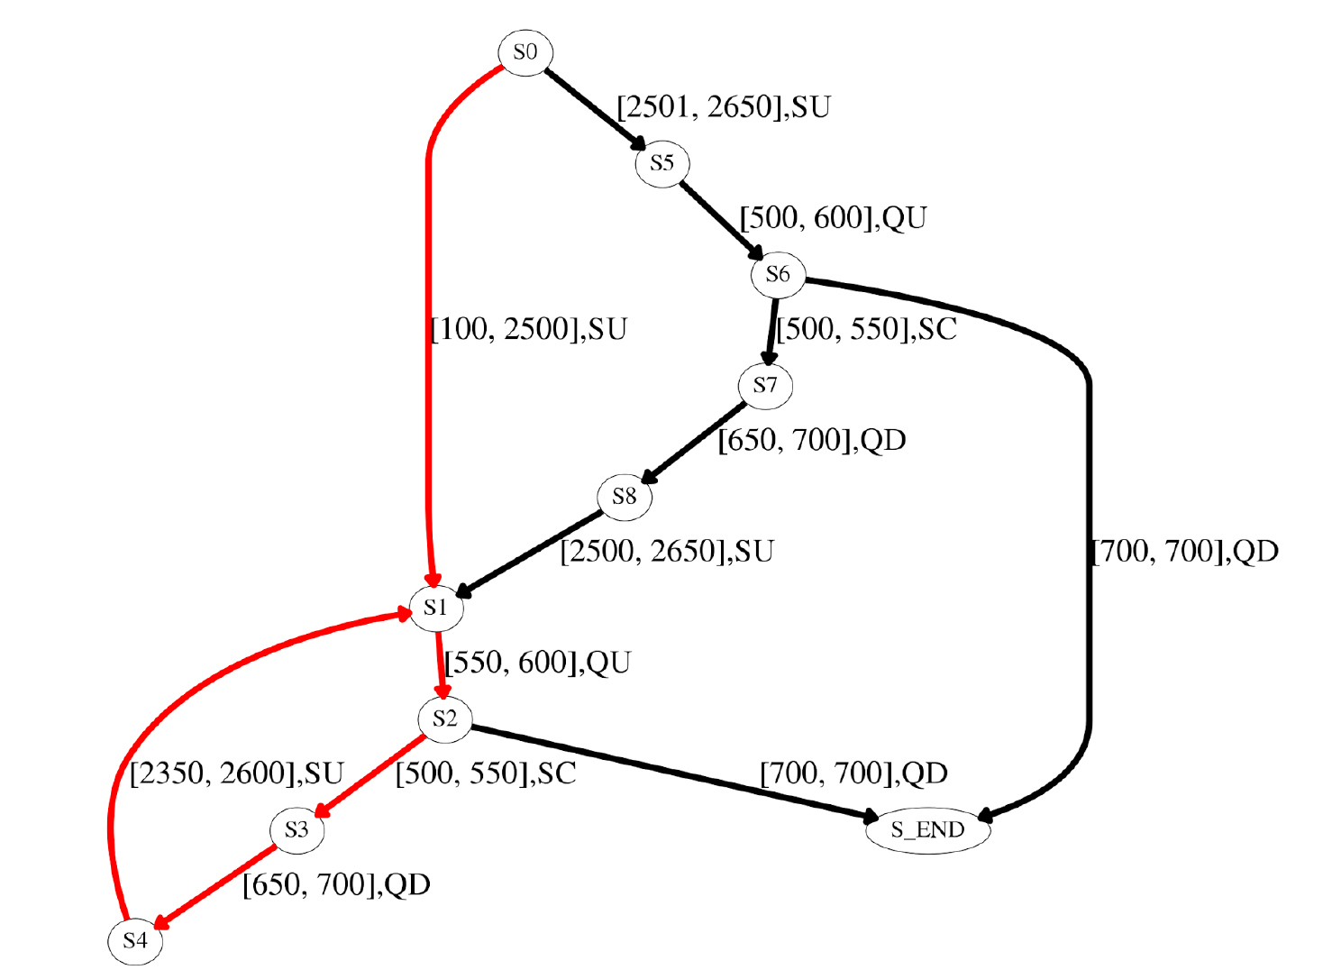
More interpretable state machine model of signal
SU = slightly up
QU = quickly down
SC = stay constant
QD = quickly down
[u,v] are temporal
bounds

Slide 84
Important choices in discretization
The level of aggregation
Discretize every individual data point, a sequence of points, with or without gaps?
The behavior to model
Exact values, trends, differences, fluctuations?
My advice:
do what makes sense and leads to interpretable outcomes
when uncertain: try different possibilities

Slide 85
Learning from text
Typically approaches:
Bags of Words
count word occurrences (spam filters, not this course)
Markov chains
predict next word given current word (time series modeling, malware detection)
N-grams
predict next word, given pervious N-1 words (author attribution, malware detection)
Word2Vec
create a vector out of symbol/word context (NLP)

Slide 86
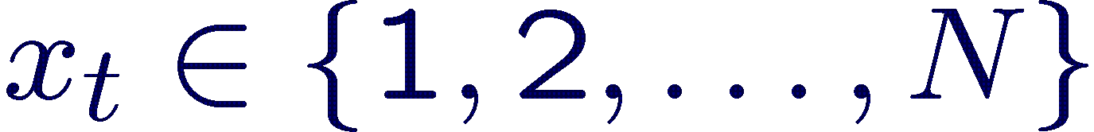
Sequential Processes
Model state-based systems
= state at time t
State evolution is typically random
Used to model the probability of state sequences and to predict future states or events

Slide 87
Markov Processes
Assumes the Markov property:
“Conditioned on the present, the future is independent from the past”

Slide 88
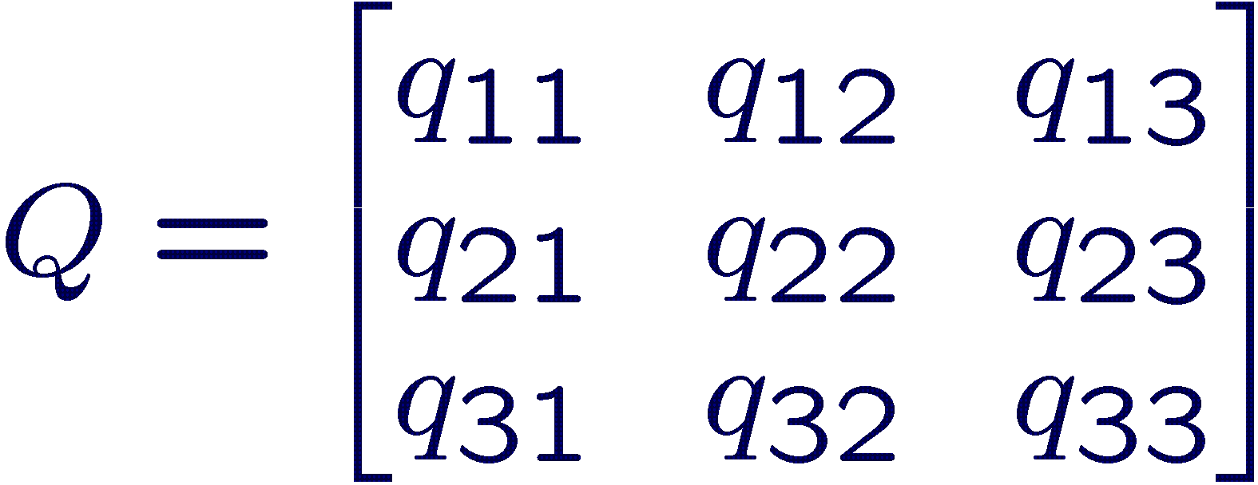
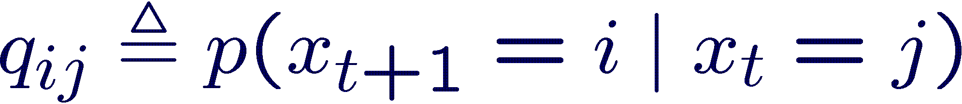
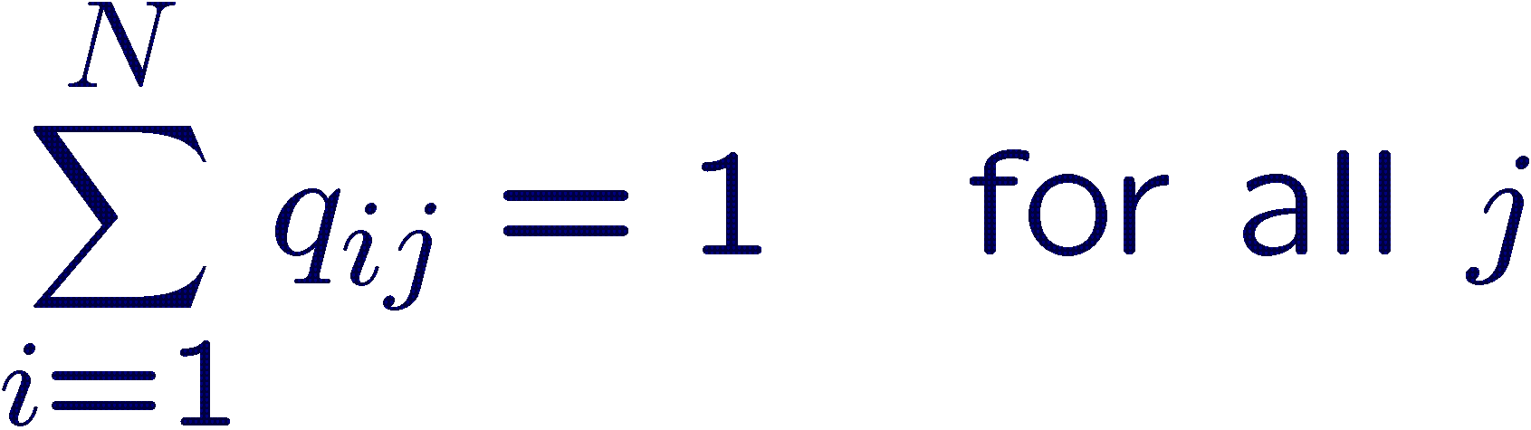
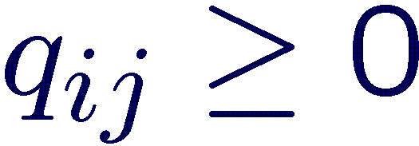
State Transition Matrices
A stationary Markov chain with N states is described by an NxN transition matrix:
Constraints on valid transition matrices:

Slide 89
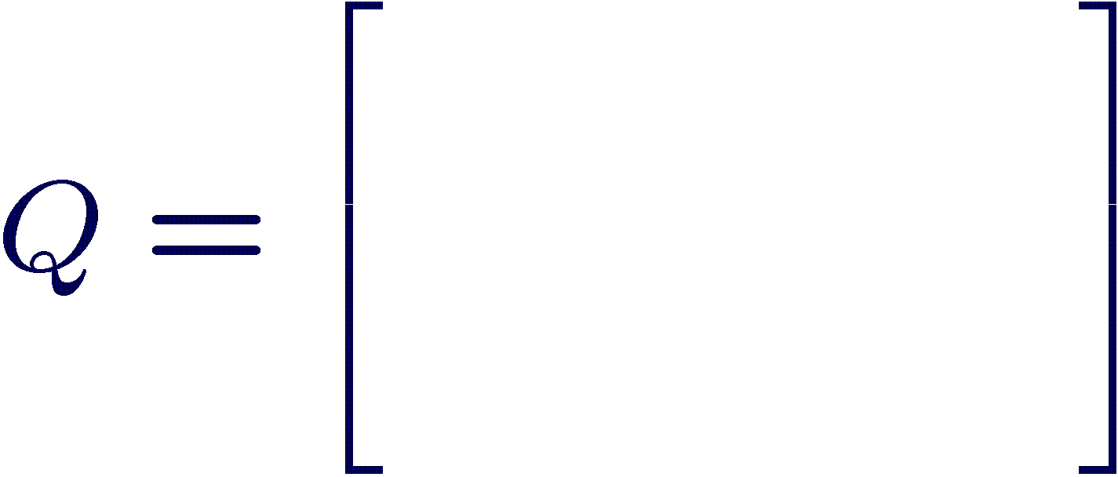
State Transition Diagrams
0.6
0.5
0.2
0.5
0.1
0.0
1
0.9
3
0.1
0.3
0.0
0.4
0.2
0.9
0.6
2
0.3
0.4

Slide 90
Parameter Estimation
value | state
4 | 1
4 | 1
8 | 2
10 | 3
11 | 3
6 | 1
8 | 2
10 | 3
14 | 3
12 | 3

Slide 91
Parameter Estimation
value | state
4 | 1
4 | 1
8 | 2
10 | 3
11 | 3
6 | 1
8 | 2
10 | 3
14 | 3
12 | 3
1
3
2

Slide 92
Parameter Estimation
value | state
4 | 1
4 | 1
8 | 2
10 | 3
11 | 3
6 | 1
8 | 2
10 | 3
14 | 3
12 | 3
1
1
3
2
2
Count transition occurrences

Slide 93
Parameter Estimation
value | state
4 | 1
4 | 1
8 | 2
10 | 3
11 | 3
6 | 1
8 | 2
10 | 3
14 | 3
12 | 3
1
1
2
3
2
2
Count transition occurrences

Slide 94
Parameter Estimation
3
value | state
4 | 1
4 | 1
8 | 2
10 | 3
11 | 3
6 | 1
8 | 2
10 | 3
14 | 3
12 | 3
1
1
1
2
3
2
2
Count transition occurrences

Slide 95
Parameter Estimation
3/4
value | state
4 | 1
4 | 1
8 | 2
10 | 3
11 | 3
6 | 1
8 | 2
10 | 3
14 | 3
12 | 3
1/3
1/4
1
1
3
2/3
2
Normalize transition counts
to sum up to 1.0

Slide 96
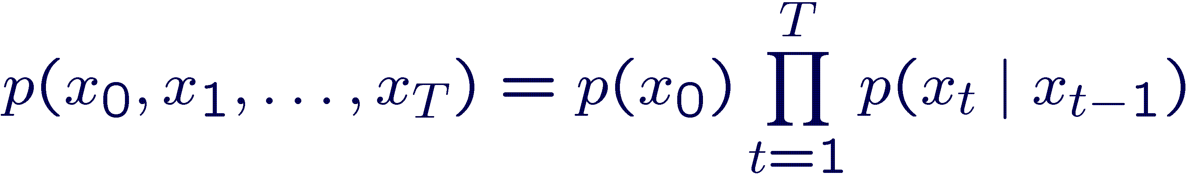
Predicting new state sequences
Prob(1123) =
P(1) * P(1→1) * P(1→2) * P(2 →2) =
?
3/4
1/3
1/4
1
1
3
2/3
2

Slide 97
Predicting new state sequences
Prob(1123) =
P(1) * P(1→1) * P(1→2) * P(2 →2) =
3/10 * 1/3 * 2/3 * 1 =
6/90
3/4
1/3
1/4
1
1
3
2/3
2

Slide 98
Avoiding zero probabilities
Some sequences, i.e., 1121, have zero probability under this model
Models typically assume that everything has non-zero probability
This is avoided using smoothing
3/4
1/3
1/4
1
1
3
2/3
2

Slide 99
Laplace smoothing
Add a count of 1 to every possible state transition before normalization
3
1
1
1
3
2
2
2

Slide 100
Laplace smoothing
Add a count of 1 to every possible state transition before normalization
4
2
1
1
2
3
3
1
2
1
3
1

Slide 101
Laplace smoothing
Add a count of 1 to every possible state transition before normalization
4/7
2/6
1/6
1
2/7
3/5
3
1/5
2
1/7
3/6
1/5

Slide 102
Markov chains
Intuitive representation of sequence probabilities
Structure is informative
Easy to estimate and use
Large bias, low variance
Only applicable when the state is observed!
(hidden state discussed in software data lecture)
Huge amount of applications in physics, statistics, economics, …

Slide 103
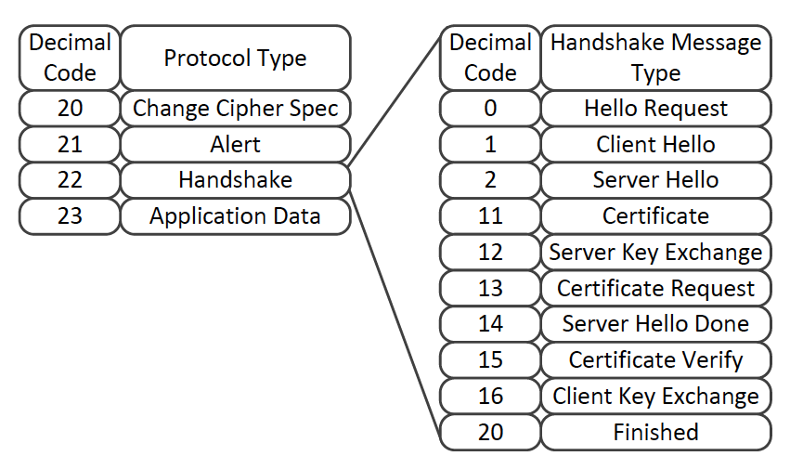
Encrypted traffic classification using MCs
SSL/TLS sessions, ignoring payloads
Input:
22:2-22:11,22:14-20:,22:-23:
22:2,20:,22:-23:
22:2-22:11,22:14-20:,22:-23:-23:-21:
Every message type (22:2-22:11, etc.) is a state in a Markov chain

Slide 104
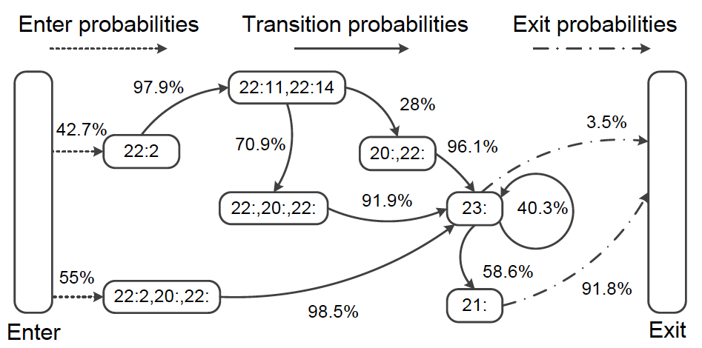
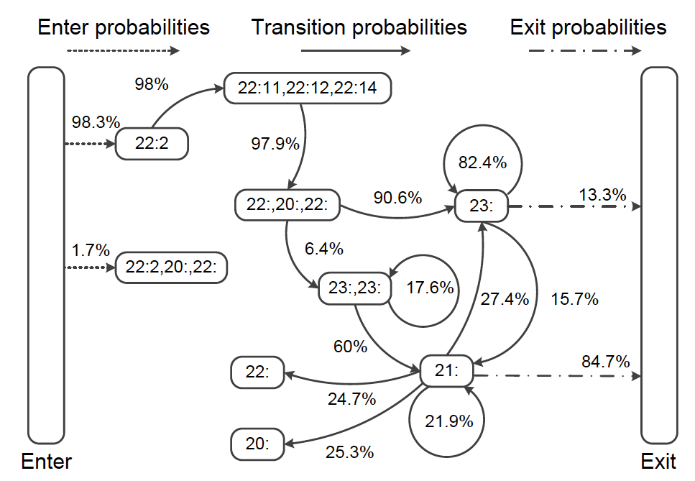
Example Markov chains
For Twitter:
For Dropbox:

Slide 105
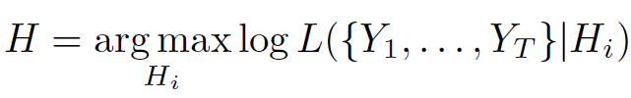
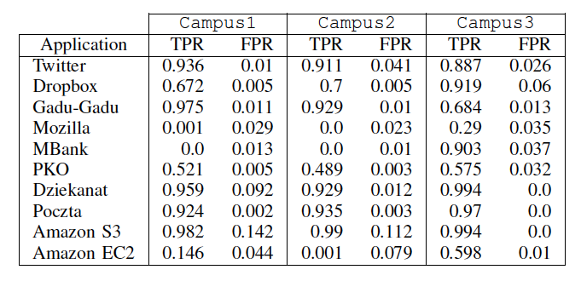
Classification using maximum likelihood
Classify new traffic using the Markov chain that maximizes likelihood:
Some results:

Slide 106
N-grams
value | symbol
4 | 1
4 | 1
8 | 2
10 | 3
11 | 3
6 | 1
8 | 2
10 | 3
14 | 3
12 | 3
s1 | s2 | s3
1 | 1 | 2
1 | 2 | 3
2 | 3 | 3
3 | 3 | 1
3 | 1 | 2
1 | 2 | 3
2 | 3 | 3
3 | 3 | 3

Slide 107
N-grams
Every combination of past sequences is a state
States:
11, 21, 31
12, 22, 32
13, 23, 33
Transitions:
P(11→12) = P(2|11) =
P(112) / P(11?)
s1 | s2 | s3
1 | 1 | 2
1 | 2 | 3
2 | 3 | 3
3 | 3 | 1
3 | 1 | 2
1 | 2 | 3
2 | 3 | 3
3 | 3 | 3

Slide 108
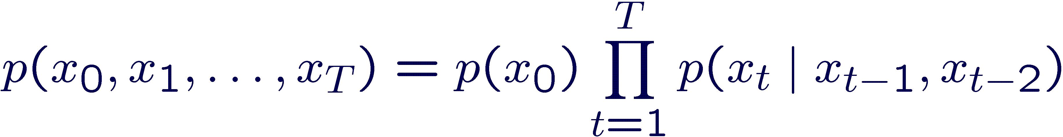
N-grams
Every combination of past sequences is a state
s1 | s2 | s3
1 | 1 | 2
1 | 2 | 3
2 | 3 | 3
3 | 3 | 1
3 | 1 | 2
1 | 2 | 3
2 | 3 | 3
3 | 3 | 3
Prob(1123) =
P(11) * P(11→12) * P(12→23) =
1/8 * 1 * 1 = 1/8

Slide 109
N-grams
Popular tools in natural language processing (NLP)
Other names: bigrams, trigrams, higher-order Markov chains
Almost always need to be combined with smoothing methods to avoid overfitting
Laplace (add X counts)
Back-off, learn N-grams for N in {1, .. , N} if Nth model is badly estimated, use N-1th model, ...
…
Only approximates the true model, structure is not very meaningful to visualize or analyze…

Slide 110
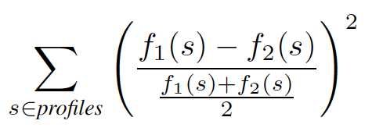
Malware detection using Byte n-grams
Learn profiles from known malicious code:
n-grams, where every word/symbol is a byte from a malicious executable
Keep top L n-grams (most frequent for each file)
Match these profiles using Nearest Neighbor, with somewhat arbitrary distance:
where fi(s) is the frequency of n-gram s in file I
More common is to use cosine, or word2vec

Slide 111
N-gram table
 | Ngram 1 | Ngram 2 | Ngram 3 | …
File 1 | f(1,1) | f(1,2) | f(1,3)
File 2 | f(2,1) | f(2,2) | f(2,3)
File 3 | f(3,1) | f(3,2) | f(3,3)
…
With f(x,y) the frequency of Ngram y in File x
You can apply any ML method to this table…

Slide 112
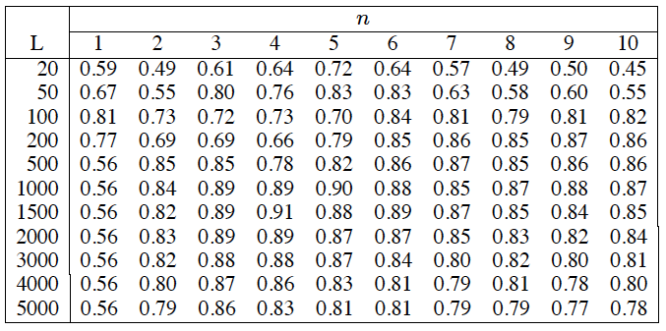
Reported detection rates, see paper

Slide 113
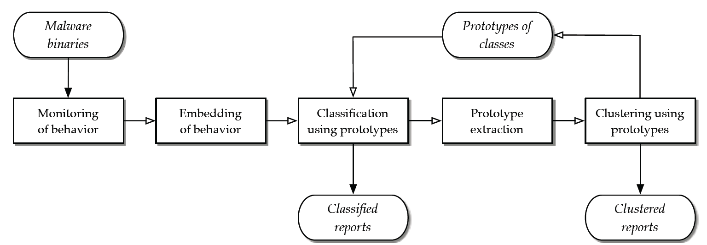
Malware detection using MIST n-grams

Slide 114
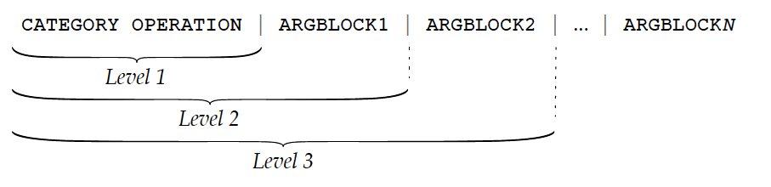
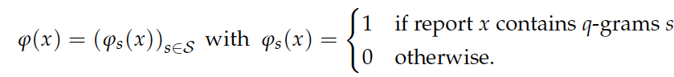
Malware detection using MIST (malware instructions set) n-grams
MIST instructions are words
About 100.000 unique 2-grams… but sparsely embedded as binary vectors
Classify using nearest prototype...

Slide 115
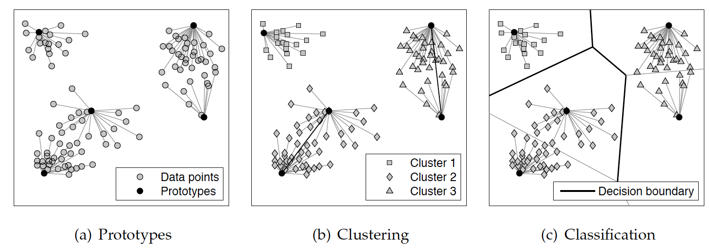
Prototyping
Simple solution to speed up Nearest Neighbor
Finding best prototypes is NP-hard, but can be approximated

Slide 116
Prototyping
Simple solution to speed up Nearest Neighbor
Finding best prototypes is NP-hard, but can be approximated
Reduces number of required comparisons from thousands to a handful!

Slide 117
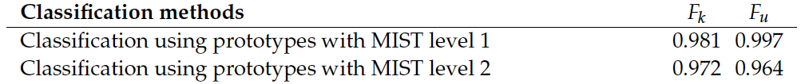
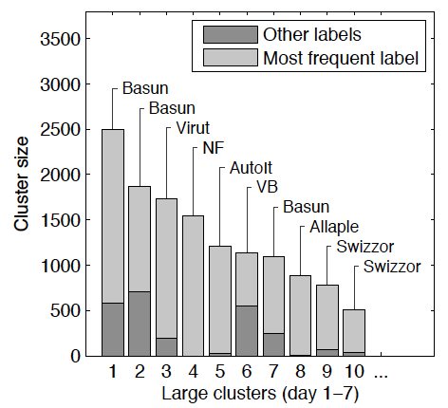
Some results
High accuracy scores
and, sensible clusters

Slide 118
Overview
Applying standard machine learning methods
Time slicing, sliding windows → order, how far to look back in time
Computing distances → shapes matter, normalize, align
Modeling time-series
Auto-Regressive (AR) → similar to sliding window, use PACF
Moving Average (MA) → models fluctuations, use ACF
Differencing → also useful for other methods!
Filtering noise, Fourier transform → see end of presentation
Discrete sequential models
Markov chains → simple but insightful
N-grams → count local patterns, sum counts over longer periods

Slide 119
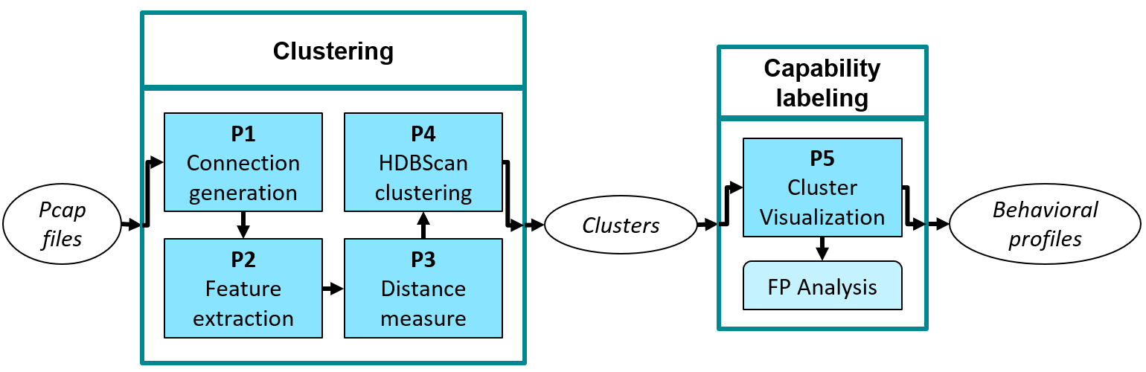
Clustering malware using DTW and Ngrams with cosine distance
A. Nadeem et al.

Slide 120
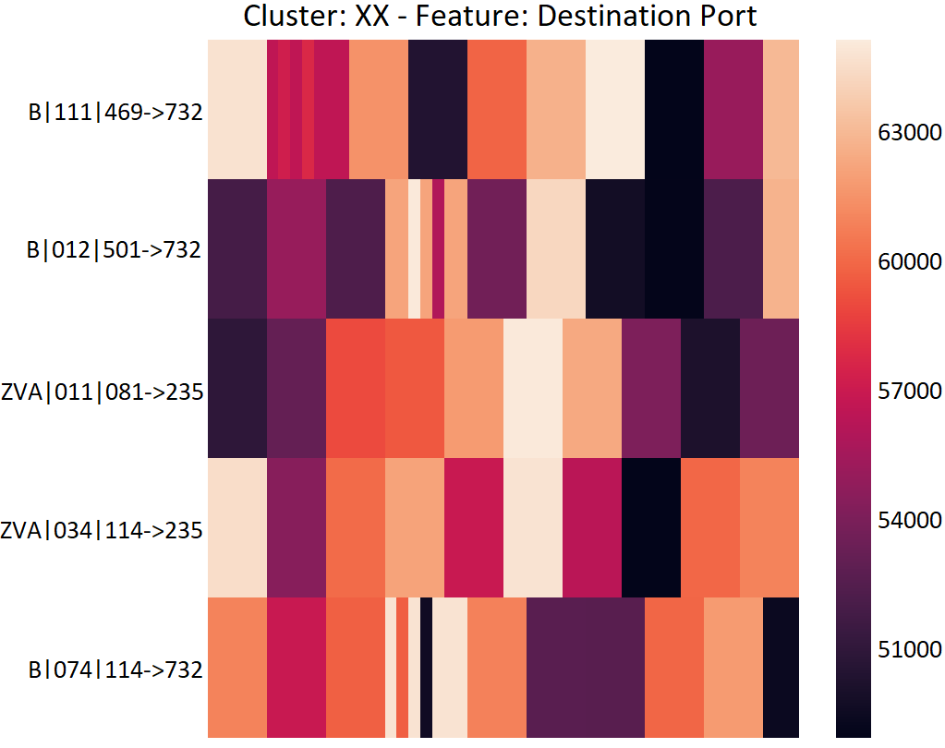
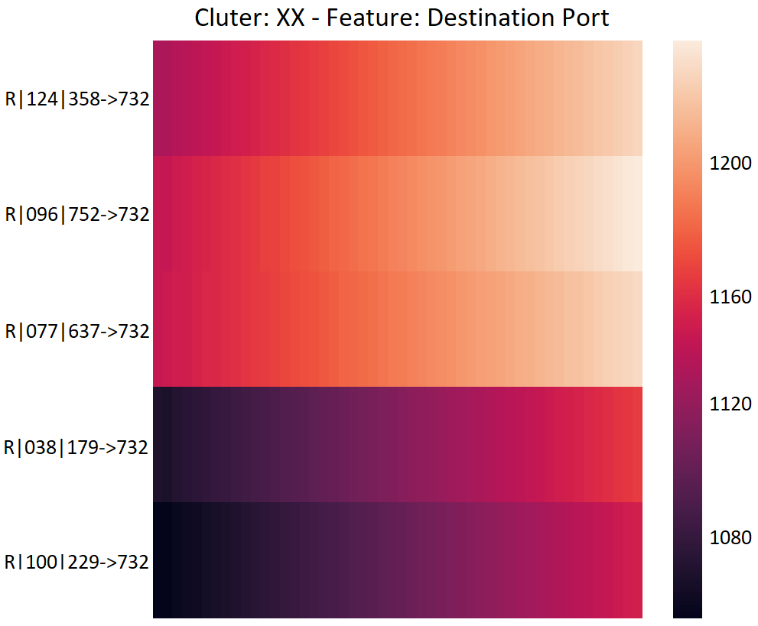
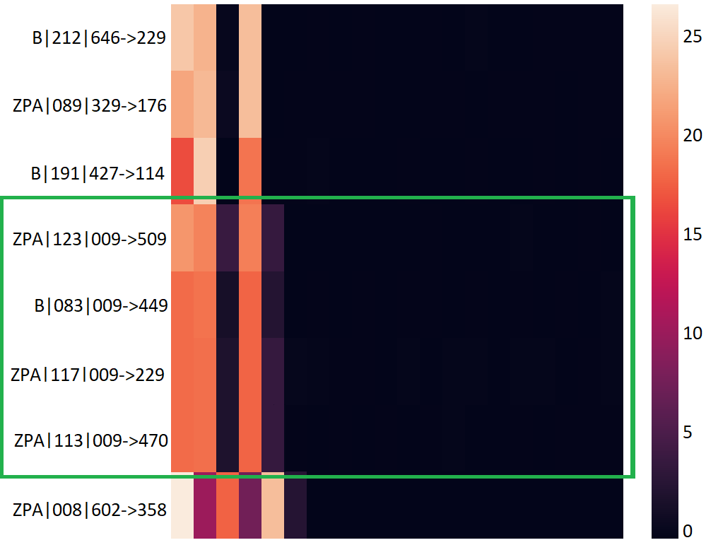
Clustering malware using DTW and Ngrams with cosine distance
Ngrams correctly
capture randomized
and structured
portscans
DTW finds behavioral similarities
Between Zeus and Blackmoon
botnets
A. Nadeem et al.

Slide 121

Clustering malware using DTW and Ngrams with cosine distance
Clusters malware into
behavioral families
completely unsupervised
A. Nadeem et al.

Slide 122
What else?
The slides showed several key sequential modeling methods
But there are many more, e.g.:
PCA/Autoencoder also commonly used over sliding windows for anomaly detection
Word2Vec maps discrete sequences back to numerical data, very commonly used in natural language processing
Gaussian Processes are a common Bayesian method for time series (do not fit a model, but a distribution over models and sample from that distribution, marginalize and condition on data)
Hidden Markov models, State Machines, LTSM networks, will be discussed in software data lecture.

Slide 123
Schedule
week | topic | lab | deadline
1 – 21 April | Intro & Fraud | Fraud data | Team up
2 – 28 April | Imbalanced Data & Privacy
5 May | Liberation Day
3 – 12 May | Anomaly Detection | Anomaly data | Fraud
4 – 19 May | Sequential Data Mining
5 – 26 May | Stream Mining | Network traffic | Anomaly
6 – 2 June | Software Data
7 – 9 June | Adversarial Machine Learning | Malware data | Network
25 June |  |  | Malware
So far, applied standard data mining & machine learning techniques
From next week, the menu contains more specialized algorithms

Slide 124

De-noising of signals
Signals are inevitably polluted by noise due to some uncontrollable events, which causing bad influence on time series modeling and prediction.
Frequency analysis: A completely different perspective on time series data

Slide 125


Fourier transform

Slide 126
Example: noisy sine signal

Slide 127
Removing the noise
Step1: frequency analysis of the signal with Fourier transform (from time domain to frequency domain)
spectrum of signal

Slide 128
Removing the noise
Step2: select the frequency area of useful signal and that of noise
(in frequency domain)
noise
noise
useful signal

Slide 129
Removing the noise
Step3: reduce the magnitude of noise (in frequency domain)
noise
noise

Slide 130
Removing the noise
Step4: reverse the spectrum with inverse-Fourier transform (from frequency domain to time domain)
de-noised signal

Slide 131
Results

Slide 132


Wind-speed signal
signal polluted by noise

Slide 133

Wind-speed signal

Slide 134
Wind-speed signal
useful signal
noise

Slide 135

Wind-speed signal
de-noised signal

